Slide 1

RNN part B
WHERE THINGS START TO GET TRICKY...

Slide 2
Our Workflow
1
2
Understanding the dataset
Exploratory data analysis
3
4
Feature engineering
Model architecture
5
6
Model improvement
Evaluation metrics

Slide 3
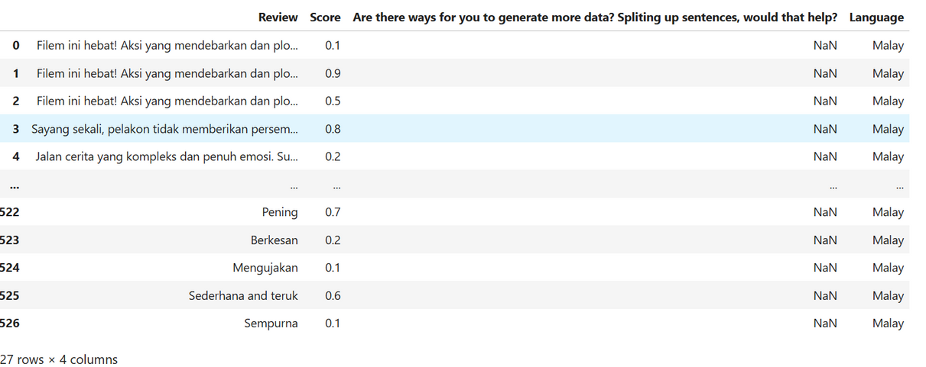
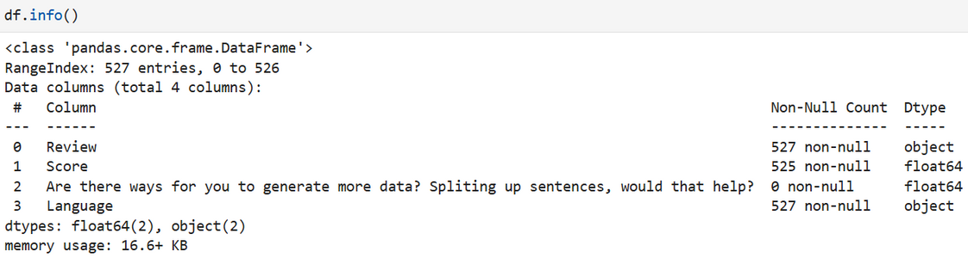
Understanding the dataset
Columns:
- Review: Free-text movie review
- Score: A numerical value (0.0 to 1.0) — this suggests a regression or classification target.
- Language: e.g., Malay, and possibly other languages
Regression or classification?
Score ranges from 0.0 to 1.0 — we can:
- Convert it to classification (e.g., binary: positive/negative)
- Or do a regression if fine-grained sentiment is needed

Slide 4
Exploratory Data Analysis
 | 0.9 | English
 | 0.1 | English
Filem ini hebat! | 0.2 | Malay
Reviews
Score
Language
The movie was great!
The movie was amazing!
Translation: this movie is great! ->
What we can infer from the dataset?
After looking over the dataset, it would appear that the scoring system is inverted, meaning the reviews which are negative would be rated a high score (score >0.5) and reviews that are positive are given a lower score (score <0.5).
This suggests an inverted scoring system where the more positive a review is, the lower the score can be expected.
There also appears to be some anamolies included, such as when a review is obviously positive, they are given a very high score (score = 0.9, which is a very negative score). This could mean two things that are harming our dataset:
- Annotation error (labeling issues)
- Sarcasm

Slide 5
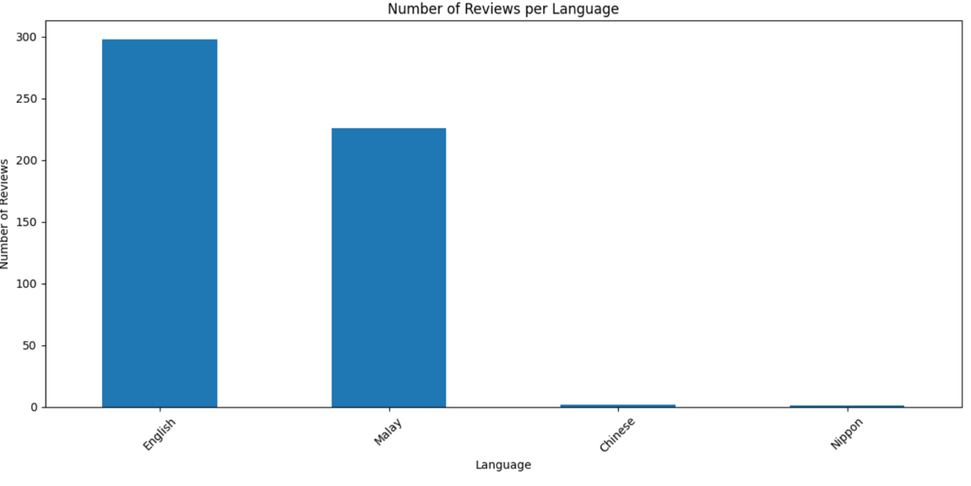
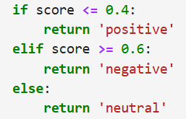

Exploratory Data Analysis
What should we do with the dataset now from this current point? based on what we can see at a first glance.
1. Find all the unique languages used in reviewing the movie
2. Label scores that are < 0.3 to be "positive" and scores > 0.7 to be "negative". While the scores in between will be labelled as neutral.
3. Labelled scores will be used for classification and the cleaned scores (floats).
4. Delete the useless column

Slide 6
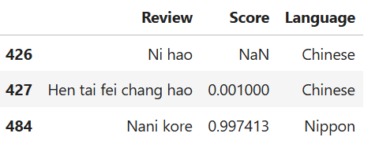
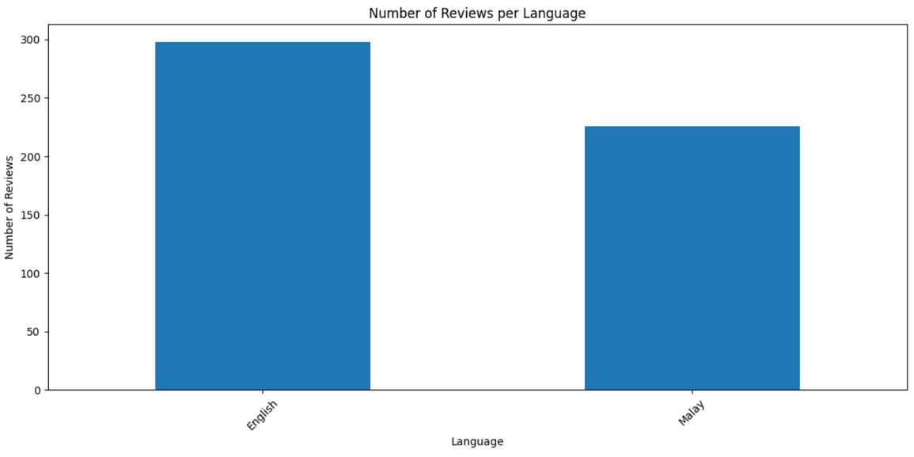
Exploratory Data Analysis
As we can see from the dataset, the reviews that are written in Chinese and Nippon only have 3 rows of data.
after furthur investigation, these specific 3 rows of data are gibberish and add no real value to count towards our dataset.
thus, we will drop them for the sake of our dataset.
After dropping:

Slide 7
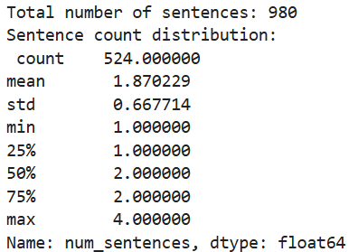
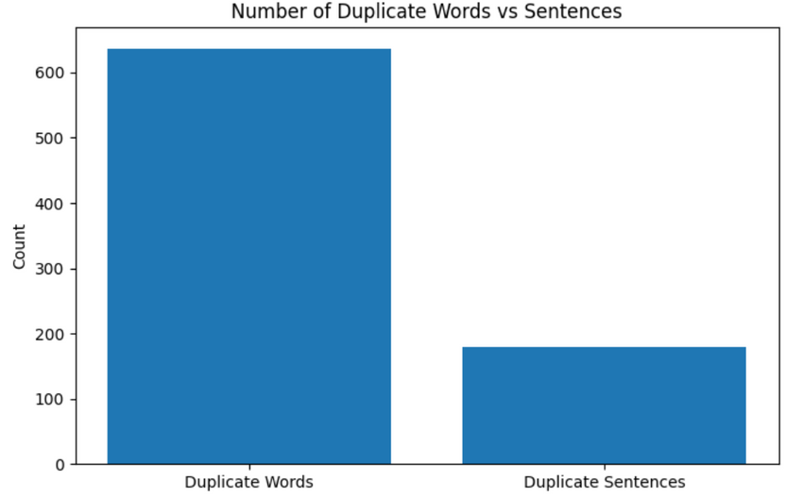
Exploratory Data Analysis
Now that we have the cleaned dataset of gibberish data. lets now look at the duplicate sentences and words there are so far
we can do so by splitting the reviews into individual words into a seperate column
Now, we can look at how many duplicates are there after splitting the sentences.

Slide 8
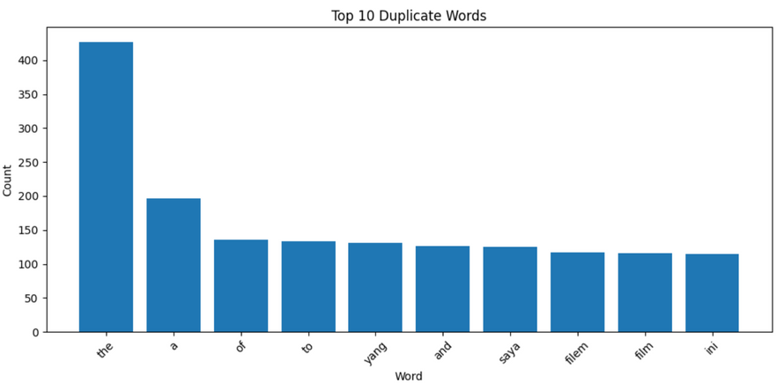
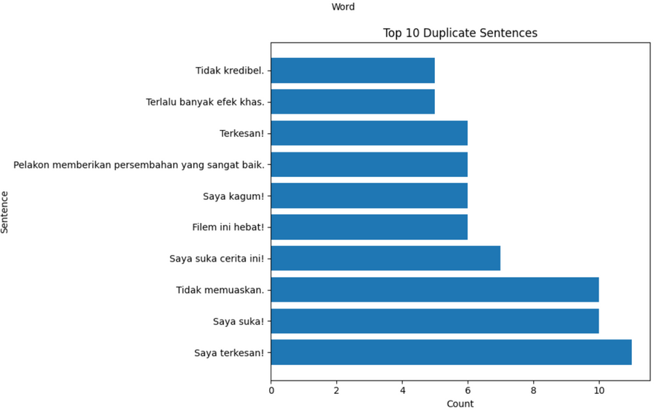
Exploratory Data Analysis
Observations for duplicates:
it would appear that most of our duplicate words are syncategorematic words (eg. a, the, of, to). meaning that they are words that they are words that do not stand by themselves and give no value to our sentiment analysis
A majority of sentences with the most duplicates are in Malay. meaning we will have to translate them to english before tokenization.
What can we do with the duplicated sentences and words and how to handle them?
by doing a duplicate sentence analysis with the score we could be able to drop the sentences that are duplicates and have the same sentiment
first we can do this by assigning labels to scores < 0.3 (positive), scores > 0.7 (negative) and anything in between to be neutral.

Slide 9
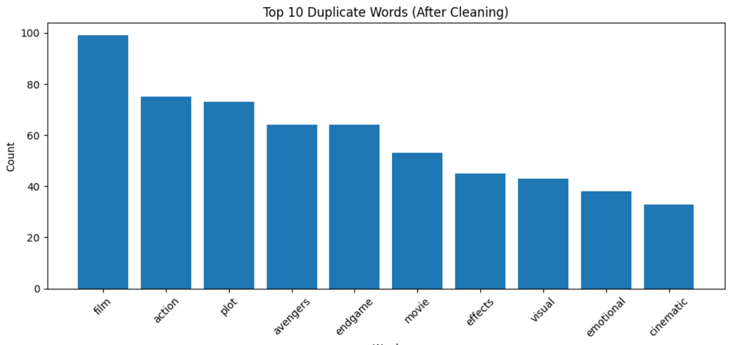
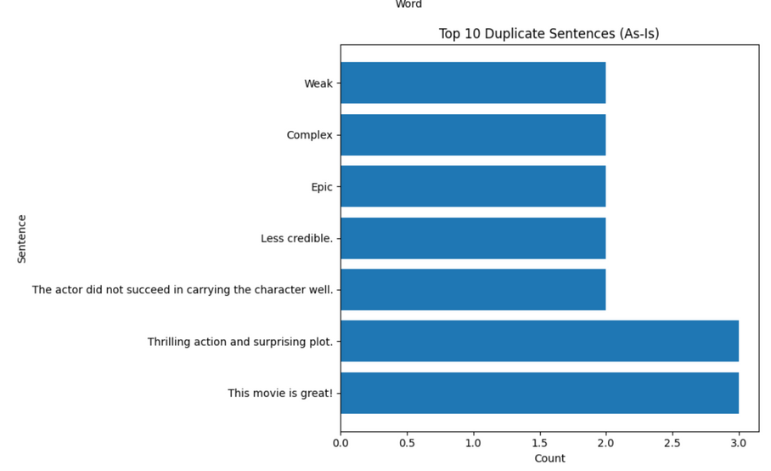
Exploratory Data Analysis
Now with the labelled sentiment for each review (postive, negative or neutral)
we can proceed with dropping duplicate reviews with the same sentiment
- an example,
Review | Label
This movie was great! | positive
This movie was great | positive
dropped ->

Slide 10

Exploratory Data Analysis
Further analysis on duplicates
After cleaning duplicates using our method. we can see that our data it alot cleaner now. with duplicate words not having syncategorematic words from both languages.
There are still some duplicated words and sentences.
However, the duplicate words are well within reason to be included when training as they provide context that is essential for sentiment analysis. thus, we no longer need to do anything with the duplicate words ✅✅✅
As for the duplicate sentences however, i found it interesting as to why these 4 stood out from our dataset. and i asked myself these questions:
1. why were there one worded sentences? and how could there be 2 different sentiment labels on the same word?
2. how could the same exact sentence have 3 possible sentiment labels as well?

Slide 11
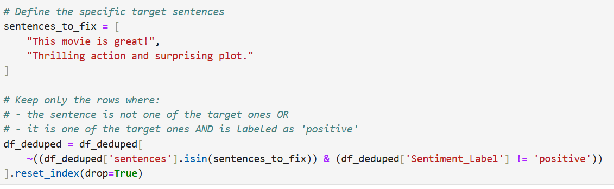
Exploratory Data Analysis
What should we do to handle them?
we need to find out how many of these one worded reviews there are and give them the correct sentiment label
i suspect there to be sarcasm involved when the same review was given a score. we find a way to correctly label those sentences with 3 sentiment labels with the correct sentiment.
after looking at the dataset, i realise that the sentences with 3 sentiment labels are from the same sentence just with varying scores.
and after running the sentence through a quick google translate, it actually meant "This movie is great! Thrilling action and a surprising plot." which is very obviously a positive sentiment. Thus, i will drop the 2 of the same review that are neutral and negative and we are only left with one that has a score of 0.1 (positive sentiment).

Slide 12
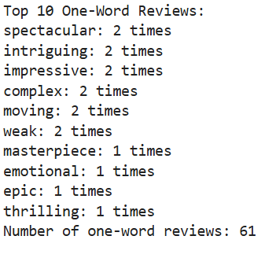
Exploratory Data Analysis
After manually dropping the sentences that are labelled with the wrong sentiment, now we can also move onto doing the same with the one worded reviews.
For example:
spectacular -> positive
weak -> negative
An observation when manually dropping duplicates:
the one-worded "complex" had a duplicate but it was hard assigning it a sentiment as it is the type of word that needs to be put in a sentence for it to make sense whether it was negative, positive or neutral.
so after some scraping in the dataset row by row, majority of the sentences that had "complex" seem to be always neutral. thus, i am assigning "complex" to be a neutral sentiment.

Slide 13
Exploratory Data Analysis
Ending statments for exploratory data analysis and data preprocessing:
we have so far managed to:
filter out words that have no meaning and are strictly for sentence structure
filter gibberish data (chinese and nippon)
solve and handle straight-forward and weird duplicates
manually label reviews with wrong sentiments
HOWEVER, the one-worded reviews caught my eye. And it made me think of what i could do for my feature engineering later. How can we use them to create more data?

Slide 14
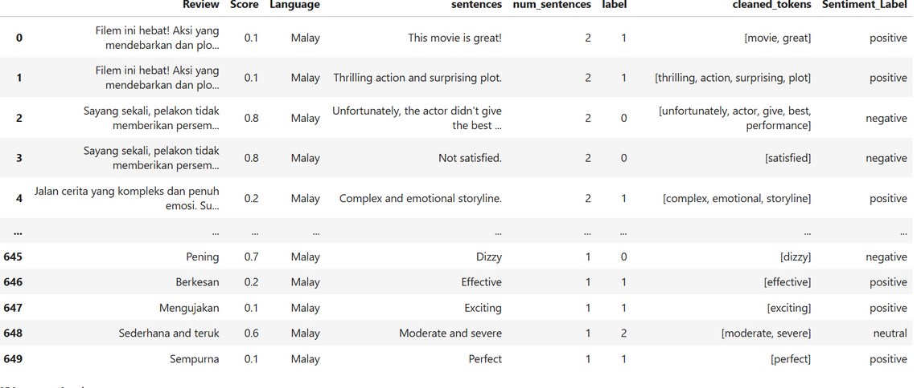
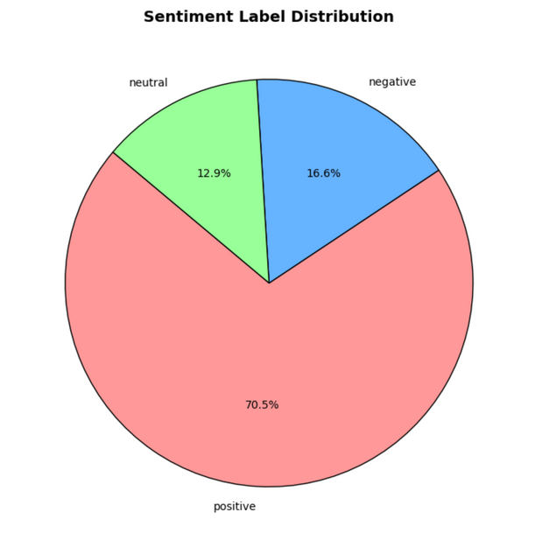
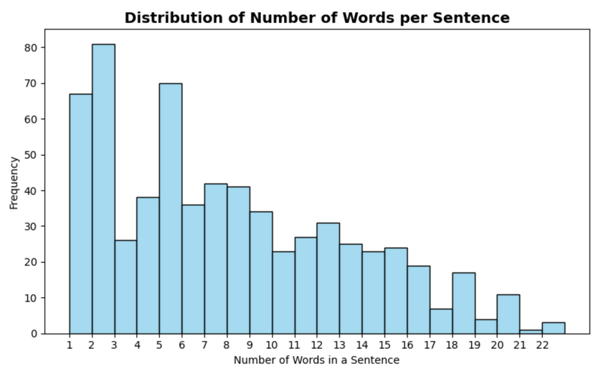
Feature Engineering
First overview of our cleaned dataset
now that we have a cleaned dataset, it's time to think of ways of how to expand and increase the amount of data that we have
this might prove difficult because of the already limited data we already have
but looking at the one and two worded reviews, it gave me an idea of how i can use Word Embedding.
so far, this will be the flow of how i will generate more data:
1. word embedding
2. short sentence expansion
3. synonym replacement
4. back translation (if needed)

Slide 15
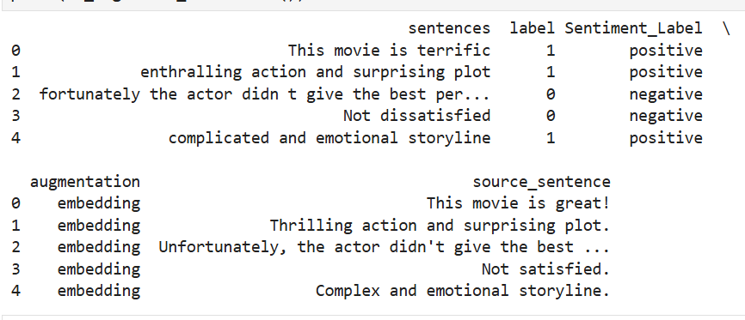
Feature Engineering
Word Embedding-Based Augmentation
- Replaces one word in each sentence with a semantically similar word using Word2Vec.
- Helps generate new sentences with the same meaning but different wording.
- Focuses only on meaningful words (ignores stopwords).
Example:
- Original: "The movie was gripping and emotional"
- Augmented: "The movie was riveting and emotional"

Slide 16
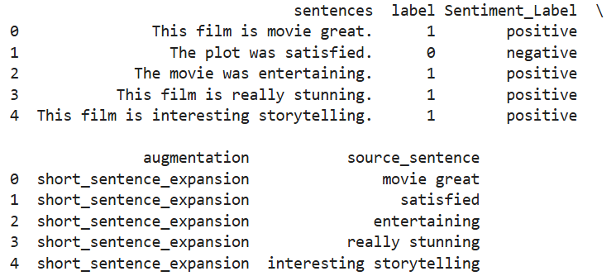
Feature Engineering
Short Sentence Expansion
- This step expands 1- to 2-word reviews into complete sentences using simple templates.
- It helps preserve valuable sentiment information from short inputs that would otherwise be weak signals to the model.
- Expansion is based on the sentiment label to maintain contextual accuracy.
Example:
- Original: "Spectacular" (positive) and "Weak" (negative)
- Expanded: "The movie was spectacular."
- Expanded: "The plot was weak."

Slide 17
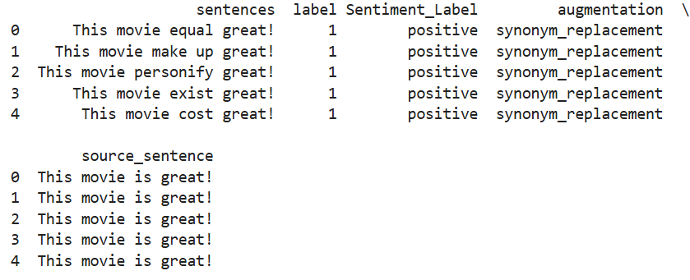
Feature Engineering
Synonym Replacement (WordNet)
- This step augments each sentence by replacing one word with up to 10 synonyms using WordNet.
- Only one word is replaced per sentence to preserve original context.
- Duplicate sentences generated across different reviews are removed to ensure variation.
Example:
- Original: "The plot was weak"
- Augmented: "The plot was feeble", "The plot was frail", "The plot was poor"

Slide 18
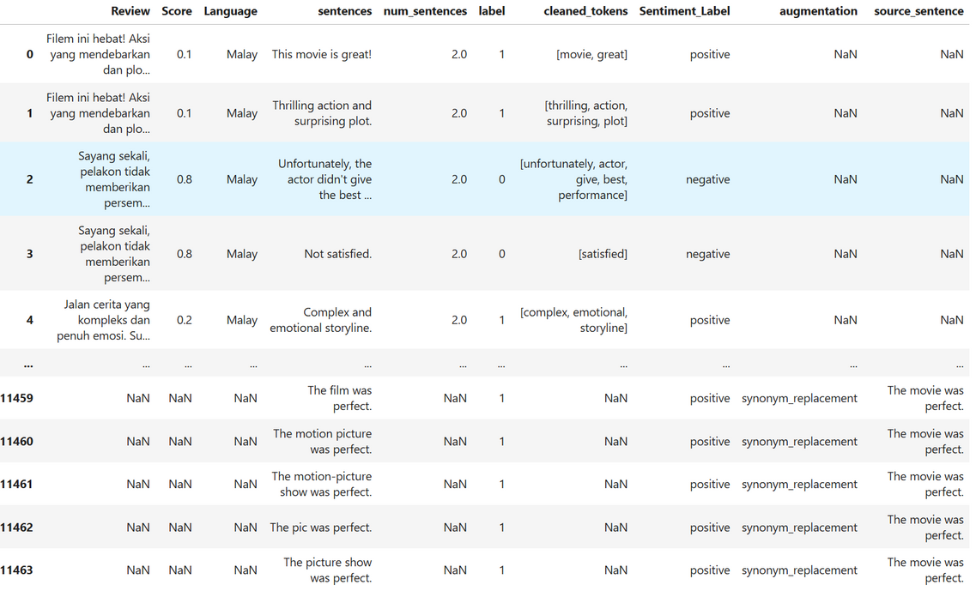
Feature Engineering
Review | Original full review in the native language (e.g., Malay). May be NaN for augmented entries.
Score | Original sentiment score (lower score = more positive). Used to derive labels.
Language | Original language of the review.
sentences | A single sentence extracted from the Review. Represents one sample input to the model.
num_sentences | Number of sentences in the full review. May be NaN for generated data.
label | Encoded sentiment class: 0 = negative, 1 = positive, 2 = neutral. Derived from Score.
cleaned_tokens | Tokenized and cleaned words from the sentence. May include stopword removal and lemmatization.
Sentiment_Label | Human-readable label matching label: negative, positive, or neutral.
augmentation | Technique used to generate the sample
source_sentence | The original sentence used to generate the augmented sentence. Null for original data.

Slide 19
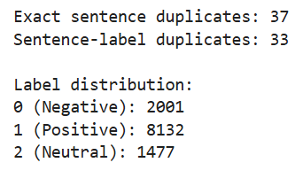
Feature Engineering
Looking at our df_all, why should we stop augmenting?
It looks like we have around 11k rows of data. i feel like this should be a good base data to feed our model and so we will be dropping the back translating step
Advantage of stopping any further data augmentation: on an already scarce dataset, we have managed to more than 100x it, and so my logic is that if we do anymore augmentation, our dataset will become increasingly unreliable
However, before we do anything more complex, now would be a good time to do a last duplicate and sanity check

Slide 20

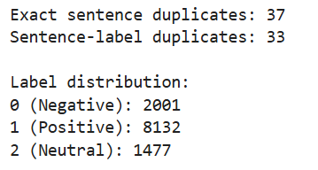

Feature Engineering
Our problem now:
As expected, after augmentation we appear to have many duplicates.
This can be expected because of the number of short sentences there were perhaps not enough synonyms for some words which caused the sentence to duplicate multiple times.
Our fix:
Solving this is simple, by writing just one line of code we can see how many sentence duplicates there are in "Sentence-labal duplicates".
By bringing in labels and subsetting it with sentences, we can see how many duplicates we can drop without worrying about losing data
More detailed explanation as to why: because (review -> "this movie is great" and the sentiment label -> "positive")*2(or more) , we can just drop the duplicate to make it only (review -> "this movie is great" and the sentiment label -> "positive")*1.

Slide 21
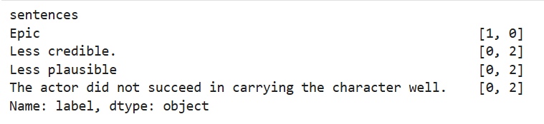
Feature Engineering
We managed to fix our sentence-label duplicates
But why do we still have an exact sentence duplicate?
It would have to mean that there is a sentence that has a duplicate but it has a different sentiment (which should be impossible)
In the end...
- now that we found who our culprits are, we can manually clean it to its correct sentiment
- the duplicate sentences that have a different sentiment will be different each time because of augmentation. thus, there is a need to manually check and input the correct sentiment each time shown below
- however, this is incredibly ineffecient as there will be different duplicate sentences each time we run the script again because of random data aug. thus, since this is also such a small part of our dataset, we should drop them.

Slide 22
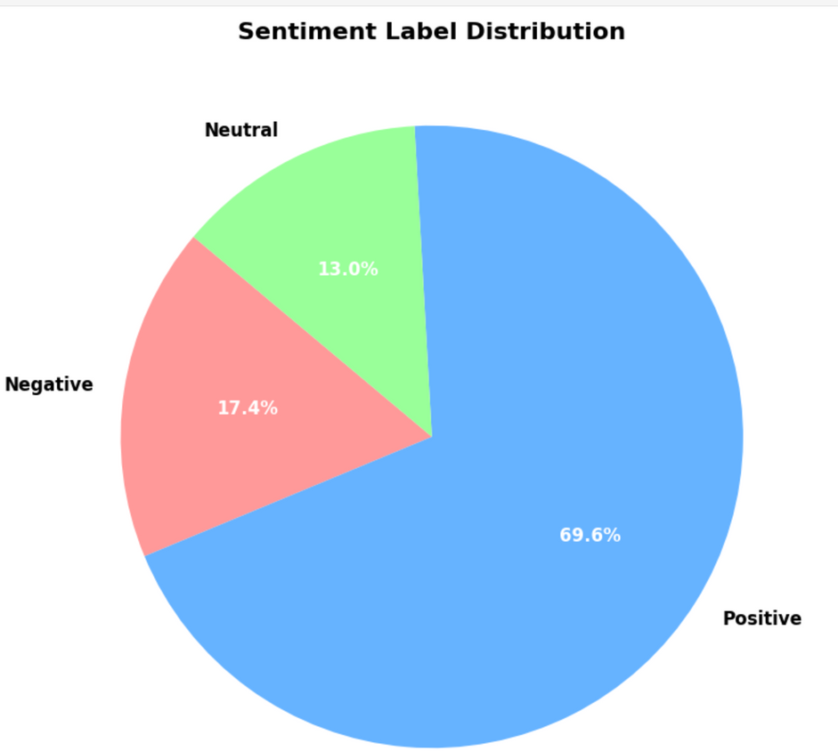
Feature Engineering
Now that we have all duplicates removed and done a sanity check
we can see that there is an overwhelming amount of positive reviews in our dataset.
meaning our model might tend to overfit to the positive class because it's seen far more often.
and that our model might struggle to learn neutral and negative patterns well
Thus, we need to do stratification for our train data.
We may proceed with tokenization and padding now!!!

Slide 23
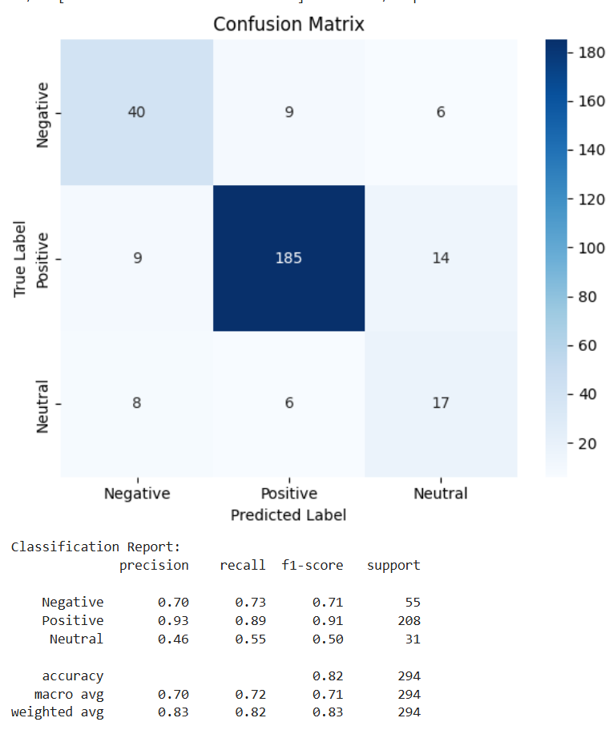
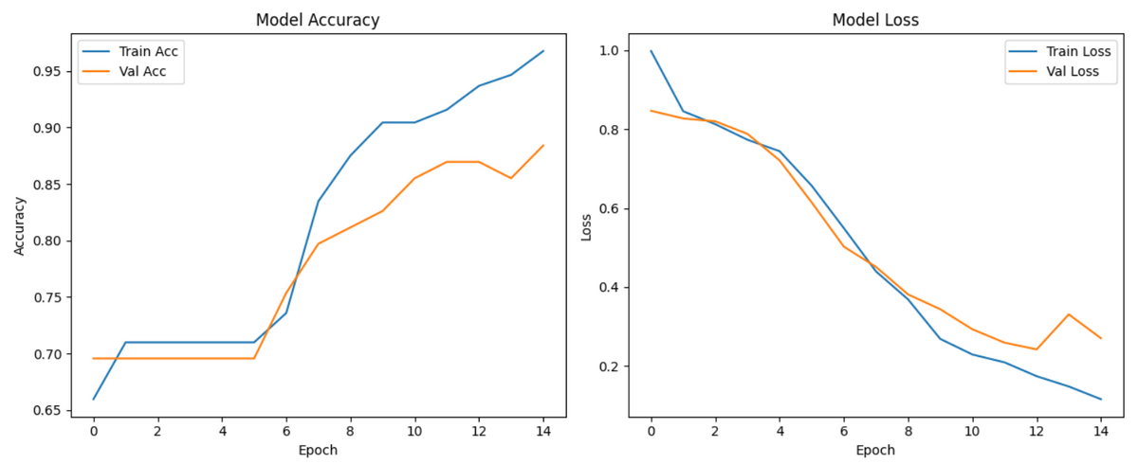
Initial model building
Observations after initial model build:
what we see upon seeing the confusion matrix:
Positive class is doing extremely well (recall = 0.89).
Neutral class is underperforming badly (recall = 0.73).
Negative is decent, but could use minor tuning.

Slide 24
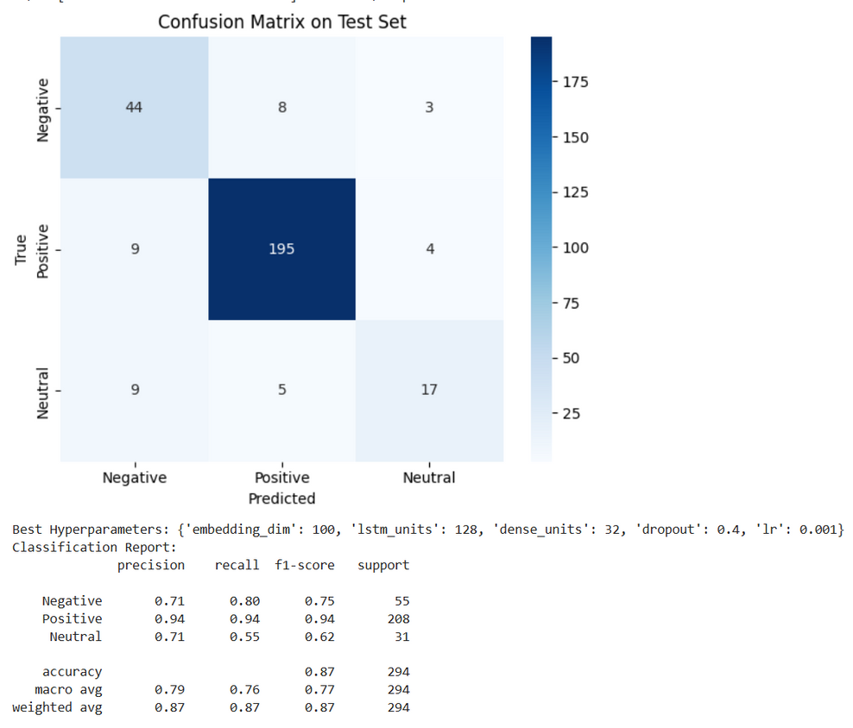
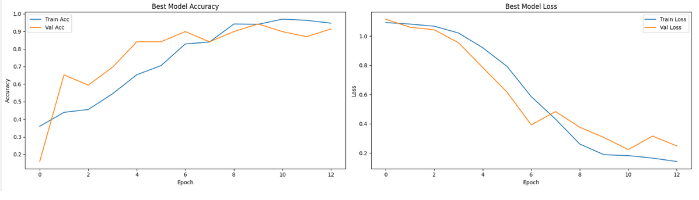
Hyperparameter tuning with class weights
Observations after hypertuning:
Our model has significantly improved in robustness, class balance, and generalization compared to the base model.
Positive class remains dominant and highly predictable.
Neutral class recall improved (from 0.31 → 0.55), indicating better detection of subtle sentiment.
Negative class has also improved recall (0.68 → 0.80), meaning fewer false negatives.
We did not look at test accuracy because it is an unreliable and unsuitable metric to this use case.

Slide 25
The End
THANK YOU FOR LISTENING

